Slide 1

SWE 425: Telecommunication Engineering with Lab
Md. Habibur Rahman
Lecturer,
Department of Software Engineering

Slide 2
+88 – 02 – 9138234/ 113
Country Code
Line Code
Trunk Code
Extension Code

Slide 3
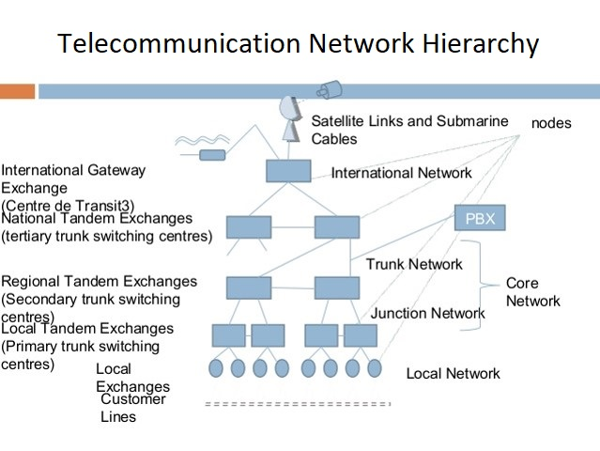

Slide 4
Lines and trunks are basically the same thing, but they're used in different situations.
Line: A line is a connection that is configured to support a normal calling load generated by one individual.
Trunk : A trunk is a circuit that is configured to support the calling loads generated by a group of users; it is the transmission facility that ties together switching systems.
Switching System : A switching system is a device that connects two transmission lines together.
Tandem Exchange: It connects a few local exchange situated in small cities and the tandem exchange is placed in a large city.
Core network: The network which has no direct connection with subscribers is called core network
International Gateway Exchange: To make an international call or to receive an international call, the exchange which is used to establish connection is called international gateway exchange or IGX.

Slide 5
Subscriber Loop Design
The cables that connect the telephone handsets or other devices to the local switching office or end office is referred as subscriber loop or local loop. Every subscriber has his own pair of wires to the local switching office.
One end of each subscriber loop is terminated on a Main Distribution Frame (MDF) at the exchange.
The drop wires (DW) from the telephones are connected to the distribution point (DP) which is located near the subscriber's premises.
The distribution points at various locations are connected together by a distribution cables (DC) and terminated to the feeder points (FD). The DC carries 10-500 pair of wires.

Slide 6
Subscriber Loop Design
Many feeder points related to a particular geographical area connected by a branch feeder (BF).
From BF, through main feeder, all the subscriber loops are connected to MDF at the end office or local exchange.
Typically, the MF carries 1002000 pair of wires to MDF.
For the purpose of flexible interconnection such as transfer from location to other location or within the geographical area, the subscriber pair and exchange pairs are interconnected at the MDF by means of jumpers.

Slide 7
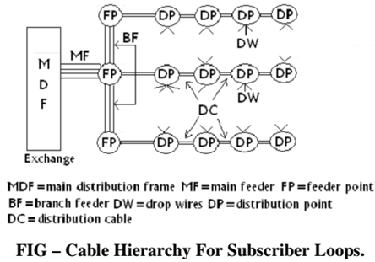

Slide 8
Telephone Exchange
A telephone exchange is a telecommunications system used in the public switched telephone network or in large enterprises. An exchange consists of electronic components and in older systems also human operators that interconnect (switch) telephone subscriber lines or virtual circuits of digital systems to establish telephone calls between subscribers.
The term telephone exchange is often used synonymously with central office (CO), a Bell System term. Often, a central office is defined as a building used to house the inside plant equipment of potentially several telephone exchanges, each serving a certain geographical area. Such an area has also been referred to as the exchange.

Slide 9
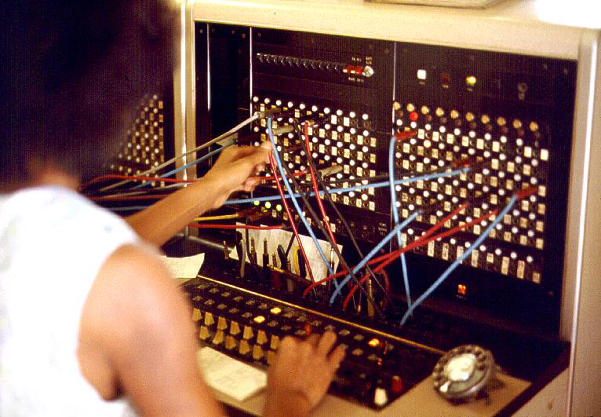
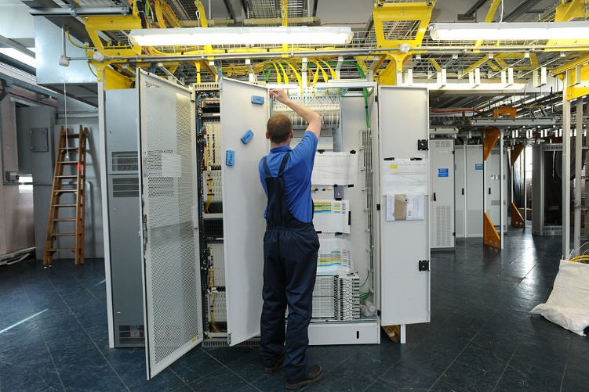
Telephone Exchange
A telephone operator manually connecting calls with cord pairs at a telephone switchboard.
A modern central office, equipped for voice communication and broadband data.

Slide 10
Private Branch Exchange (PBX)
For corporate or enterprise use, a private telephone exchange is often referred to as a private branch exchange (PBX), when it has connections to the public switched telephone network.
A PBX is installed in enterprise facilities, typically collocated with large office spaces or within an organizational campus to serve the local private telephone system and any private leased line circuits. Smaller installations might deploy a PBX or key telephone system in the office of a receptionist.
A private branch exchange is a telephony exchange or switching system that serves a private organization.
It performs the concentration of central office lines or trunks and provides intercommunication between large number of telephone stations in the organization.
There are two types of PBX:
Private Automatic Branch Exchange (PABX)
Private Manual Branch Exchange (PMBX)

Slide 11
Private Branch Exchange Functions
A Private Branch Exchange interconnects devices and allows them to make internal calls without using the public switched telephone network.
These internal calls are free of charge.
This has the advantage of not requiring a separate connection to the public switched telephone network for each phone. The existing lines can therefore be used quite efficiently.
The maximum number of parallel calls which can be made depends on the number of exchange lines.

Slide 12
Private Branch Exchange Functions
From outside, the extensions on the telephone system can either be called via an extension suffix to the main number or a central switchboard.
Call centers often use the queue function of a telephone system. This will hold a call in a queue until an agent connected to the telephone system is available and then transfers the call.
Many telephone systems are able to record a large volume of data and statistics to precisely analyze a company’s call volume.
Some telephone systems allow the system administrator to assign different rights to different extensions, for instance for outward dialing. So expensive international calls, for example, can only be placed from specific extensions.

Slide 13
Advantages of using a PBX
Internal Communications
Save Money
Centralized Control
Automation
Flexible Call Routing
Variable Access
Cost Monitoring

Slide 14
Thank You !!!
Any Questions ???

